Slide 1

Agile Development
Ron Bal
CS-250 Agile Presentation
10/13/2022

Slide 2
Agile Roles
Product Owner: Maximize value of the work done by the development team and the product.
Scrum Master: Leader to the Scrum team providing adherence to Scrum theory, pracitices, and its rules.
Development Team: Deliver releasable increments based on the definition of done at the end of each sprint.

Slide 3
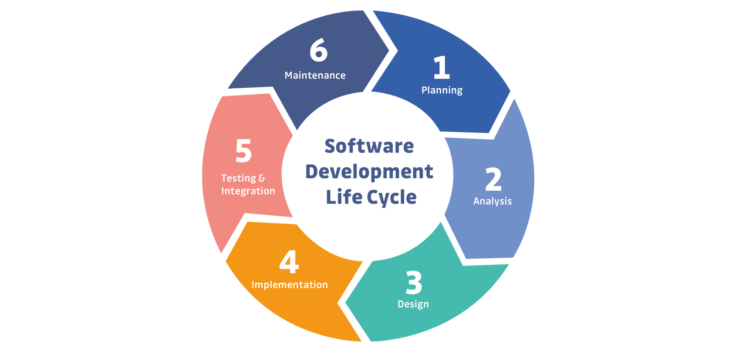
Software Development Lifecycle
Planning
Create and define the information into User Stories.
Analysis
Use the information from the user stories and efficiently implement them into the backlog.
Design
Come up with a plan on how to implement the customer's needs.
Implementation
Implement the information from user stories and such to meet the final product goal.
Testing & Integration
Create and use test cases to ensure the product works as intended.
Maintenance
Once the project has been completed, keep the product running as intended.

Slide 4

Waterfall
Top Down approach
Upfront planning
Project scope, cost, and timeline is outlined
Easily adaptable to new team members

Slide 5
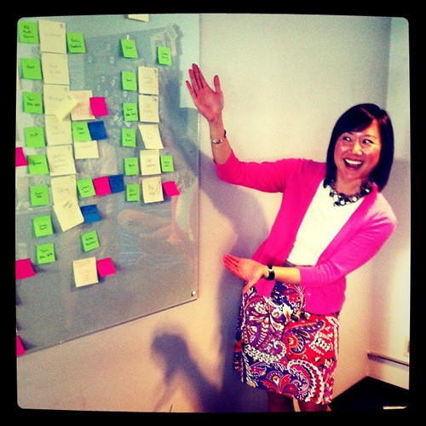
Agile
Adaptable to rewrites or revisits.
Each aspect of a project is tested allowing for quick delivery
Easily adaptable when changes are required

Slide 6
Factors to consider choosing agile or waterfall
What is the time frame of the project?
How many features will need to be implemented?
Could there be a focus change during the project?
Are there cost limitations?
Could there be personnel change?
Consider:

Slide 7
Resources
Jackson, M. (2022, July 12). Securing your SDLC (software development life cycle). GitGuardian Blog - Automated Secrets Detection. Retrieved October 13, 2022, from https://blog.gitguardian.com/securing-your-sdlc-software-development-life-cycle/
Project Management — agile vs. Waterfall - Adobe Experience Cloud. (n.d.). Retrieved October 13, 2022, from https://business.adobe.com/blog/basics/agile-vs-waterfall
Charles G. Cobb. (2015). The Project Manager’s Guide to Mastering Agile : Principles and Practices for an Adaptive Approach. Wiley.

